Slide 1
LOTTERY SCHEDULING
Presented By
SUSMITHA THUMMA MANISHA BOLISETTY ALEKYA VANGA

Slide 2
LOTTERY SCHEDULING
Lottery Scheduling is type of process scheduling, somewhat different from other Scheduling. Processes are scheduled in a random manner. Lottery scheduling can be preemptive or non-preemptive. It also solves the problem of starvation. Giving each process at least one lottery ticket guarantees that it has non-zero probability of being selected at each scheduling operation.
In this scheduling every process have some tickets and scheduler picks a random ticket and process having that ticket is the winner and it is executed for a time slice and then another ticket is picked by the scheduler. These tickets represent the share of processes. A process having a higher number of tickets give it more chance to get chosen for execution.

Slide 3
Example
If we have two processes A and B having 60 and 40 tickets respectively out of total 100 tickets. CPU share of A is 60% and that of B is 40%.These shares are calculated probabilistically and not deterministically.

Slide 4
TICKET MECHANISMS
Ticket transfers
Explicit transfers of tickets from one client to another
They an be used whenever a client blocks due to some dependency
When a client waits for a reply from a server, it can temporarily transfer its tickets to the server
They eliminate priority inversions

Slide 5
Ticket inflation
Lets users create new tickets
Like printing their own money
Counterpart is ticket deflation
Normally disallowed except among mutually trusting clients
Lets them to adjust their priorities dynamically without explicit communication

Slide 6
Ticket currencies
Consider the case of a user managing multiple threads
Want to let her favor some threads over others
Without impacting the threads of other users
Will let her create new tickets but will debase the individual values of all the tickets she owns
Her tickets will be expressed in a new currency that will have a variable exchange rate with the base currency

Slide 7
Example
Let person “x” manages three threads
A has 5 tickets
B has 3 tickets
C has 2 tickets
“X” creates 5 extra tickets and assigns them to process C
“X” now has 15 tickets
These 15 tickets represent 15 units of a new currency whose exchange rate with the base currency is 10/15
The total value of “x” tickets expressed in the base currency is still equal to 10

Slide 8
Compensation tickets
I/O-bound threads are likely get less than their fair share of the CPU because they often block before their CPU quantum expires
Compensation tickets address this imbalance
A client that consumes only a fraction f of its CPU quantum can be granted a compensation ticket
Ticket inflates the value of all client tickets by 1/f until the client starts gets the CPU

Slide 9
Example
CPU quantum is 100 ms
Client A releases the CPU after 20ms
f = 0.2 or 1/5
Value of all tickets owned by A will be multiplied by 5 until A gets the CPU

Slide 10
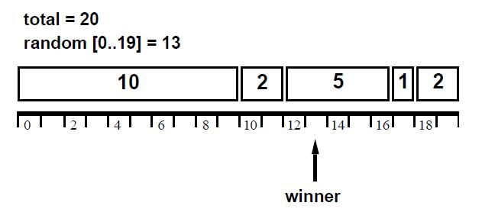
LIST BASED LOTTERY SCHEDULING
It consist of five clients.
Total number of tickets=20
Choose a random number between [0 & n-1].
Random number generated =13
Client-1 -> 10 tickets
Client-2 -> 2 tickets
Client-3 -> 5 tickets
Client-4 -> 1 tickets
Client-5 -> 2 tickets
Select the winner between the 5 clients based on list based algorithm….?

Slide 11
This technique simply requires generation of a random number and O(n) operations to traverse the existing client list of length n by accumulating the running ticket sum until the winning client is found.
If the length of the client list is very large then there are certain optimization techniques which can be implemented to reduce the number of clients that are to be examined-Tree based search.
This increases the efficiency of the system has this requires O(log n) operations to traverse the client list of length to find the client holding the winning ticket.

Slide 12
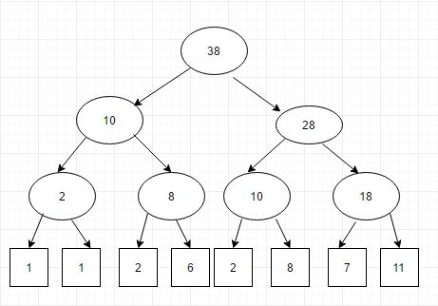
TREE BASED LOTTERY SCHEDULING
This is the tree of partial ticket sums with clients at the leaves.
To locate the client holding a winning ticket, the tree is traversed starting at the root node, and ending with the winning client leaf node.
This is mostly used in the distributed lottery scheduler

Slide 13
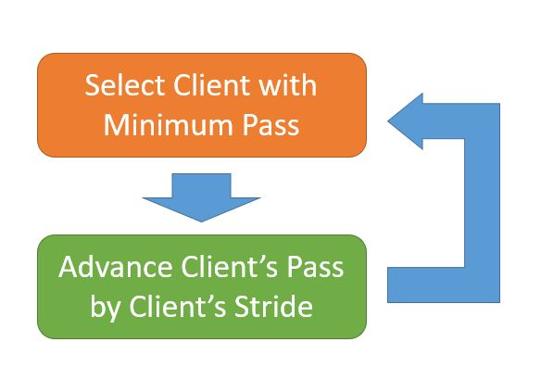
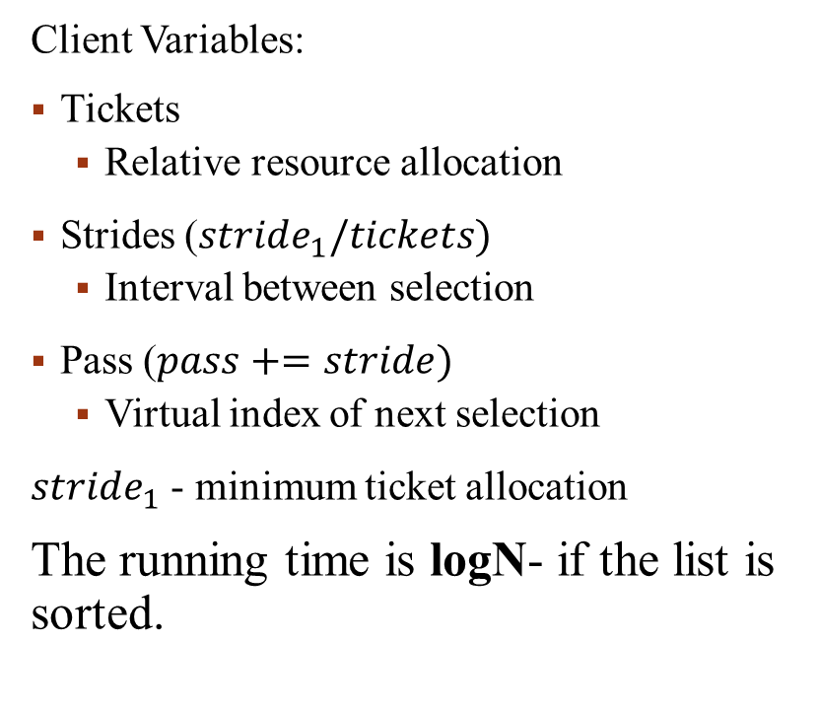
Stride Scheduling
Client Variables:
Tickets
Relative resource allocation
Strides ($stride_{1}/tickets)$
Interval between selection
Pass ($pass+=stride)$
Virtual index of next selection
$stride_{1}$ - minimum ticket allocation
The running time is logN- if the list is sorted.

Slide 14
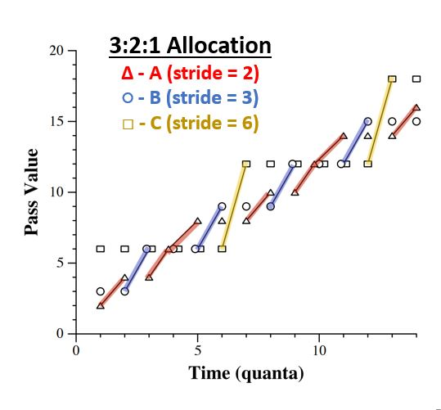
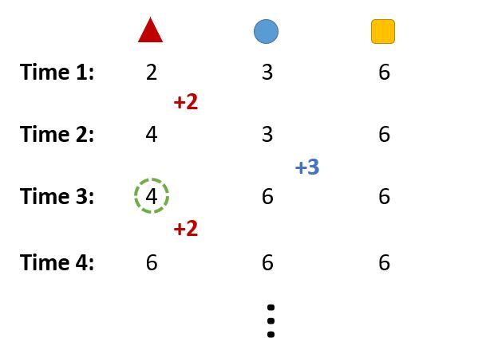

Slide 15
Hybrid Lottery Scheduler
It includes kernel priorities:
- to reduce kernel lock conflict &
- to cut short the time quanta
by increasing the responsiveness to preempting processes before there quanta expires.
For example, a process holding a vnode locked will have a higher priority than a process holding a buffer waiting for disk I/O because vnodes have been deemed a more contended or important resource. This is done by using FreeBSD scheduler.

Slide 16
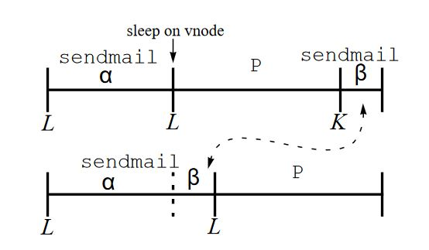
This shows processes being scheduled as time moves from left to right.
L indicates a scheduling decision by the standard lottery scheduling algorithm while
K shows where a process holding a kernel priority runs without having been chosen by the standard lottery scheduling algorithm

Slide 17
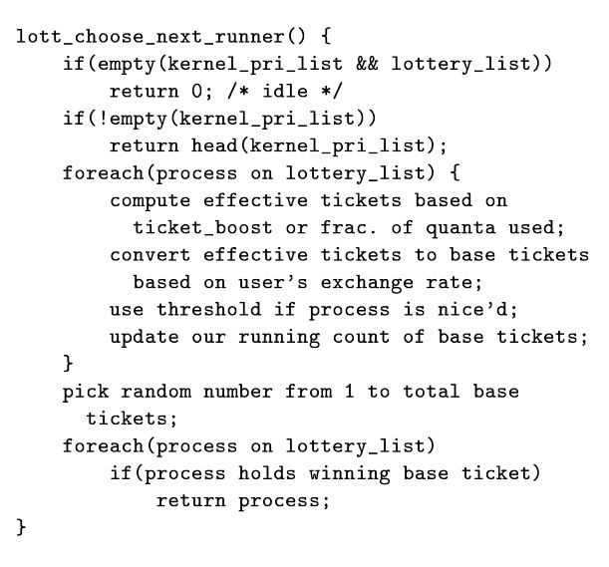
Implementation

Slide 18
Formation and analysis of Lottery scheduling

Slide 19


















Structural Scheme
P
1
P
P
2
5
P
P
3
4
Structural Scheme

Slide 20
Cont…
Behaviour of structural scheme is found on symmetry with respect to each process.
Here the consistency of all processes during execution depends on increase or decrease at initial level and remains unaffected during entire scheduling.
Overall in this scheme, each process is scheduled with its initial level priority.

Slide 21
Subsequent or Outset Execution

Slide 22
Cont….
Subsequent or Outset Execution scheme helps in getting primitive aspect of lottery scheduling with raise in probability values of processes during execution.
In beginning of execution, probability value of each process cutback for few time quanta and then there is gain in each one. Later on all becomes steady with certain development.
So here general pattern of scheme seems to be supportive for proportional share resource management.

Slide 23
Lined order expansion

Slide 24
Cont….
After analysis, both structural scheme and lined order expansion scheme follows scheduling pattern in uniform manner and no sizable development of any processes during execution.
On the other hand, subsequent or outset execution scheme makes an effort for adding in probability values of processes during execution.
Both schemes appear to be helpful for proportional share resource management.

Slide 25
Analysis can be concluded by……
Considering Stochastic modeling that subsequent or outset execution scheme supposed to be operative and can be put forward for providing a supportive environment for randomized scheduling.

Slide 26
CONCLUSION:
Completely different programming algorithms that have dynamic management over resource consumption rates
On the entire, stride programming proven to be the simplest proportional share technique.

